Slide 1
Next Word Predictor
Nick Elliott

Slide 2
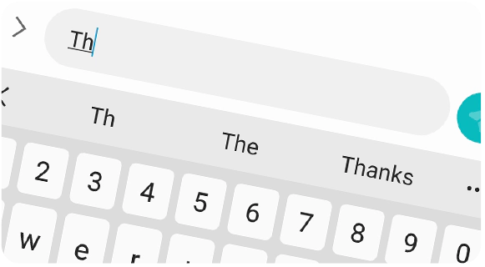
Goal
Create an application that can predict the next word following a text input
Prediction will make use of AI, specifically an Artificial Neural Network
Will feature a user-friendly user interface
Will be hosted on the cloud, and will be accessible from there
Android Predictive Text

Slide 3
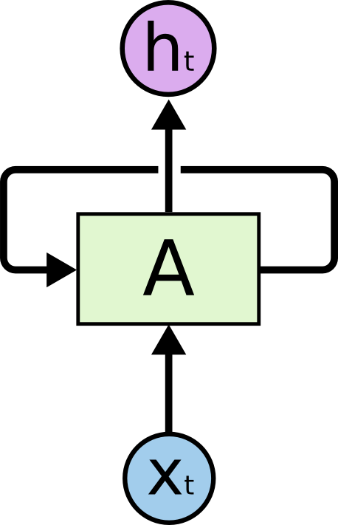
Algorithm
Problem type: Natural Language Processing (NLP)
Artificial Neural Network model
Long-Short Term Memory (LSTM):
Recurrent Neural Network - Output from nodes are re-entered into the same nodes as inputs
Data: Corpus contained in .txt file
Recurrent Neural Network

Slide 4
Features
Text input from users
Multi-word suggestion (~3-5 words)
Graphical UI controlled by keyboard commands (maybe mouse clicks as well)
File to keep track of prediction accuracy
Hosted on, and accessible from the cloud
Possible additions:
Settings selection (number of suggested words, themes, etc.)
Alternate languages

Slide 5



Technology
Python will be used to build the application
The algorithm will be created with the use of Python’s machine learning packages such as Tensorflow and Keras
The application will be hosted on a web hosting platform such as Heroku or Google Cloud

Slide 6
The End

